Slide 1

STOCK MARKET ANALYSIS
P-97 GROUP-6
Vishwas Suryawanshi
Mariah S Valiaveedan
Mohd Kaif
Mohd Anas
Mohd Faiz
Mentor- Karthik

Slide 2
PROJECT ARCHITECTURE
BUSINESS OBJECTIVE
DATA COLLECTION
EXPLORATORY DATA ANALYSIS
DATA PREPROCESSING
MODEL EVALUATION
BUILDING FINAL MODEL
MODEL DEPLOYMENT

Slide 3
Business Problem
Nowadays, the most significant challenges in the stock market is to predict the stock prices. The stock price data represents a financial time series data which becomes more difficult to predict due to its characteristics and dynamic nature.
In today’s world companies and businesses are very keen to understand and analyze the market to lower their expenses and enhance profits.
With modern data analytics, we can identify purchasing and selling patterns by carefully analyzing the data to help the investors.
Business Objective
To predict the outcomes, trends, or expected future behavior of business, industry sector, or the economy using statistics.

Slide 4
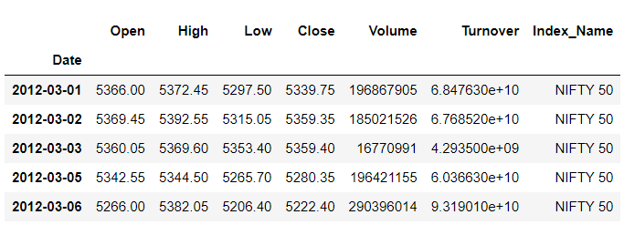
DATA COLLECTION
Website : NSE - NIFTY 50 data from 2012 to 2022
Used NSE Python (NSEPY) library to get historical data from NSE
Data Collection :
7 Columns (viz. Date, Open, High, Low, Close, Volume, Turnover, Index Name)
2477 Rows

Slide 5
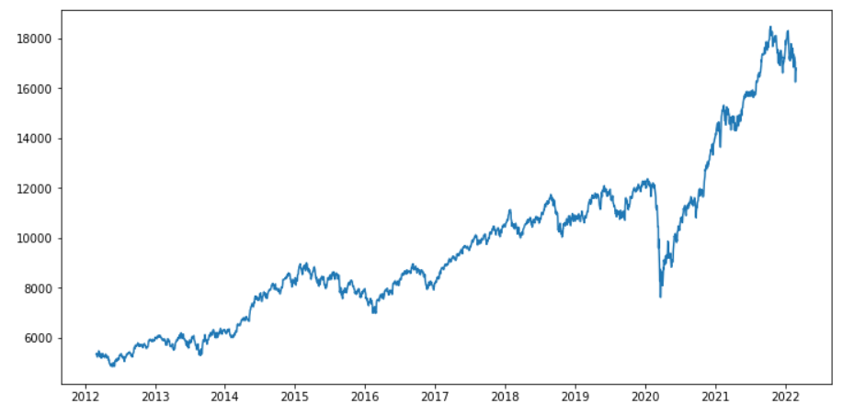
EXPLORATORY DATA ANALYSIS
LINE PLOT
Line Plot tracking of Closing Price of Stock Over Periods of Years

Slide 6
DATASET DETAILS
ROWS- 2477
COLUMNS- 7
NO NULL VALUES
NO MISSING VALUES
NO OUTLIER
DATA IS RIGHT SKEWED
COLUMNS HAVE A VERY GOOD CORRELATION WITH EACH-OTHER

Slide 7
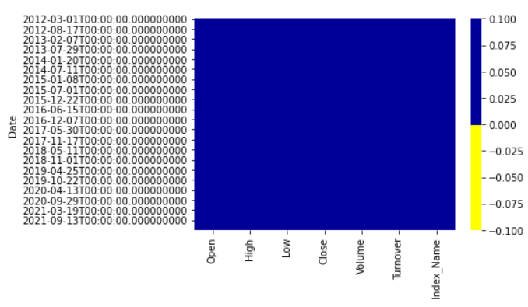
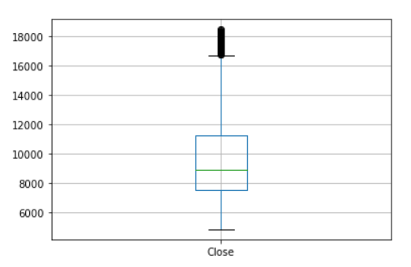
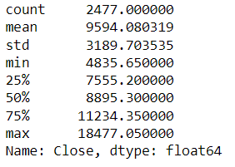
HEATMAP & BOXPLOT
Heatmap shows that there are no Missing Values in the Dataset.
Boxplot shows the result regarding the outliers.

Slide 8
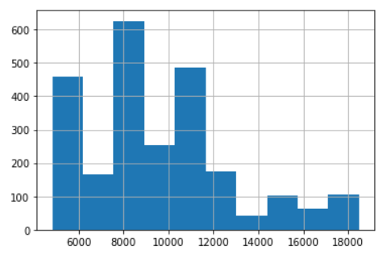
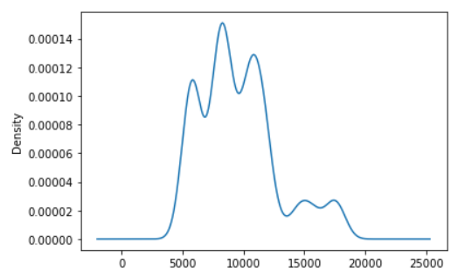
HISTOGRAM & DENSITY PLOT
Boxplot shows that the data is Right-Skewed (Positively Skewed)
Density Plot shows the range of 4000 – 14000 where the maximum data is present

Slide 9
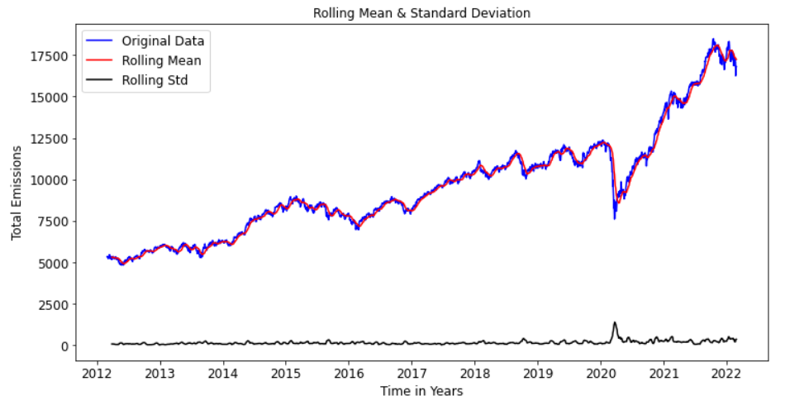
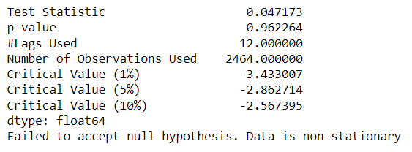
STATIONARITY CHECK
Test Stationarity by using Dickey Fuller’s Test
After applying Dickey Fuller’s Test to the data, we have found that the data is Non-Stationary

Slide 10
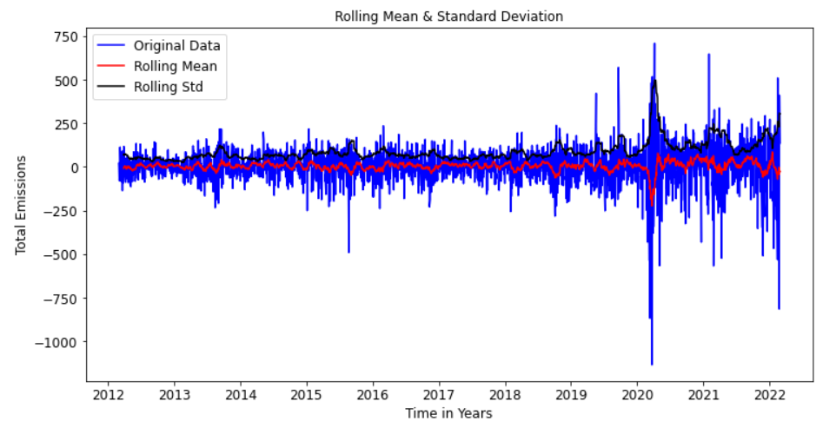
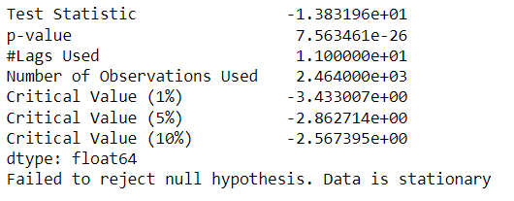
We have applied 1-Step Differencing to the data and again we have applied the Dickey Fuller’s Test to the data and we have found that the Data-Set is Stationary
Differencing has improved the Stationarity of the series significantly

Slide 11
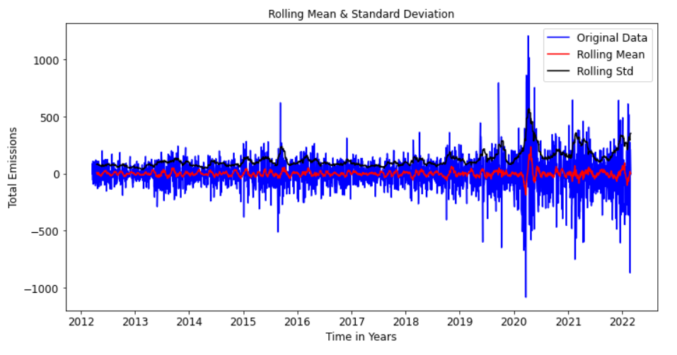
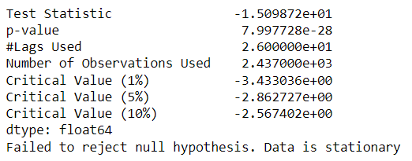
We have applied 12-Step Seasonal Differencing to the data and again we have applied the Dickey Fuller’s Test to the data and we have found that the Data-Set is Stationary
We are considering the Seasonal First Difference for the further analysis because it looks more Stationary and her Significance has also increased

Slide 12
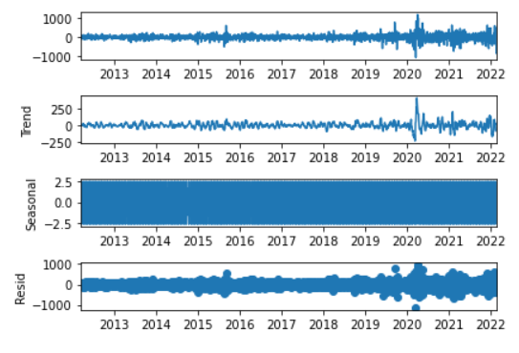
TIME SERIES DECOMPOSITION PLOT
LEVEL : First plot shows the average value in the series
TREND : Show the increasing or decreasing value in the series and has a non linear trend
SEASONALITY : Show the repeating short-term cycle in the series and now is stationary
RESID : Shows the random variation in the series

Slide 13
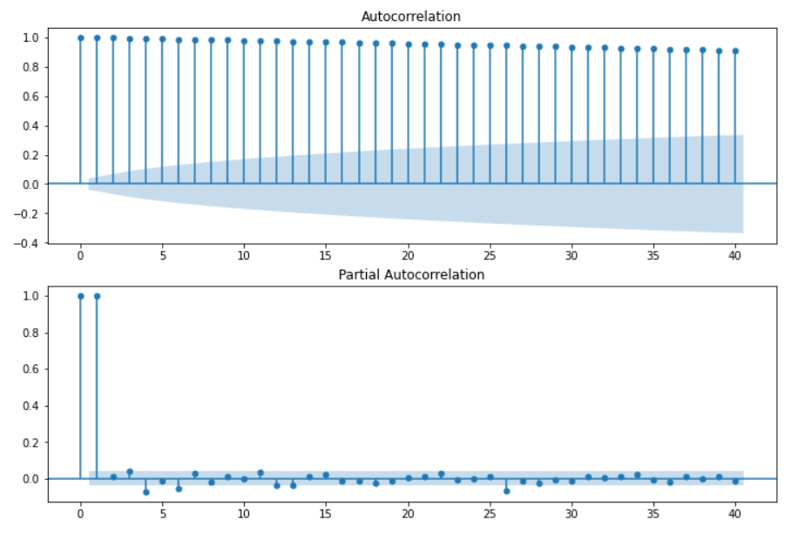
ACF & PACF PLOT
Autocorrelation Function (ACF) : It is a measure of the correlation between the time series with a lagged version of itself
Partial Autocorrelation Function (PACF) : This measures the correlation between the time series with a lagged version of itself but after eliminating the variations already explained by the intervening comparisons.
Gradual Decline in ACF Plot
Sharp Dropoff in PACF Plot

Slide 14
MODEL EVALUATION - BUILDING
DATA DRIVEN MODELS :
1. Simple Exponential Method
2. Holt’s Method
3. Holt’s Winter Exponential Smoothing with Additive Seasonality and Additive Trend
4. Holt’s Winter Exponential Smoothing with Multiplicative Seasonality and Additive Trend
5. Holt’s Winter Exponential Smoothing with Multiplicative Seasonality and Multiplicative Trend
MODEL BASED METHODS :
1. Linear Model
2. Exponential Model
3. Quadratic Model
ARIMA MODEL (Non-Stationary Dataset & Stationary Dataset)
Auto-Regressor Model
Moving Average Model
LSTM Model

Slide 15
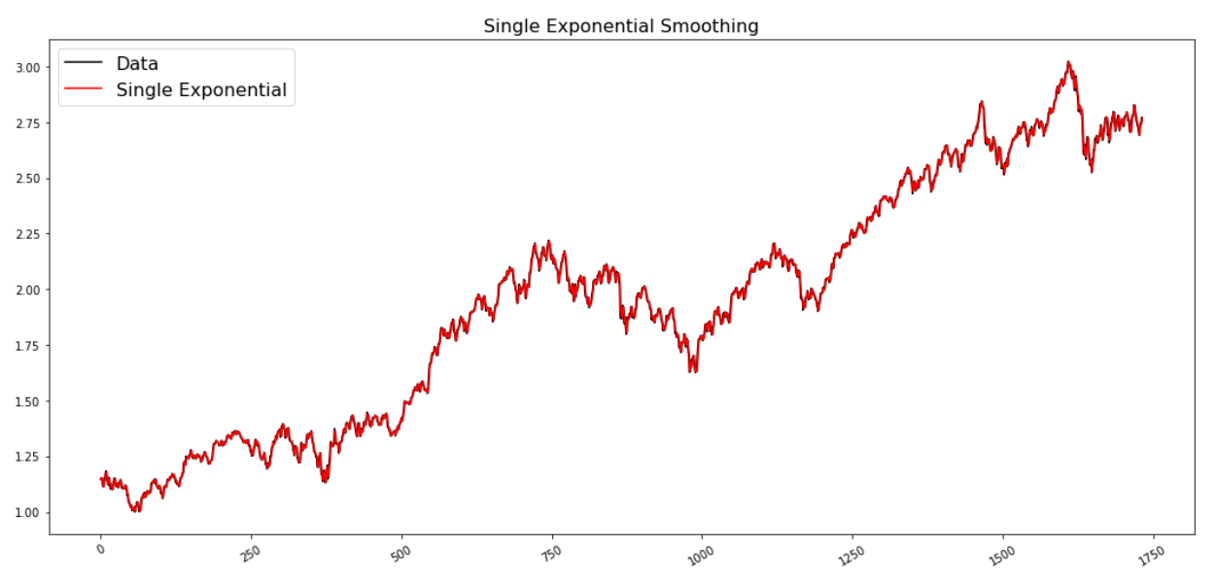
SINGLE EXPONENTIAL METHOD
Single Exponential Smoothing works on weighted averages i.e. the average of the previous level and current observation. Largest weights are associated with the recent observations and the smallest weights are associated with the oldest observations.

Slide 16
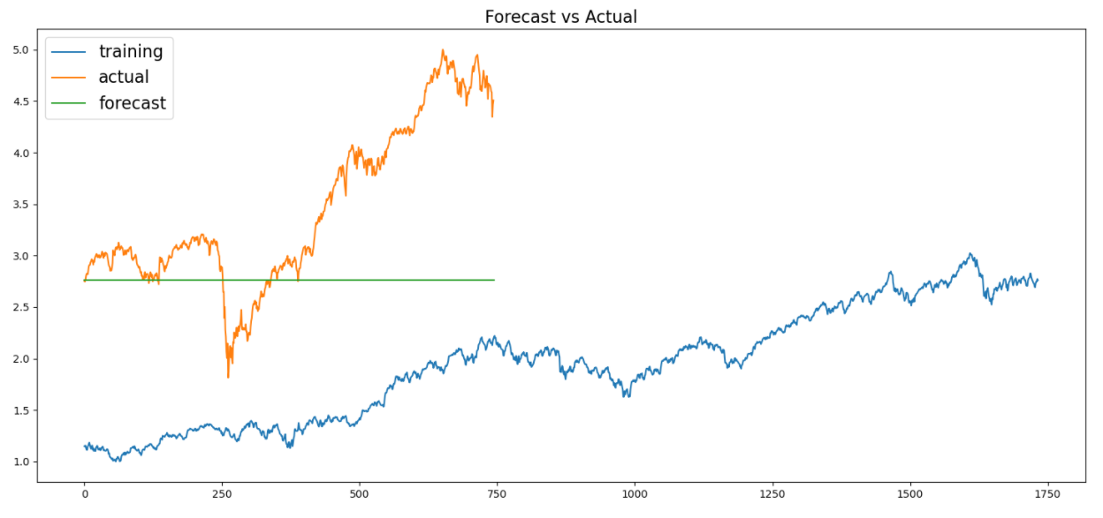
RMSE Value : 1.0489
MAPE Value : 20.1503

Slide 17
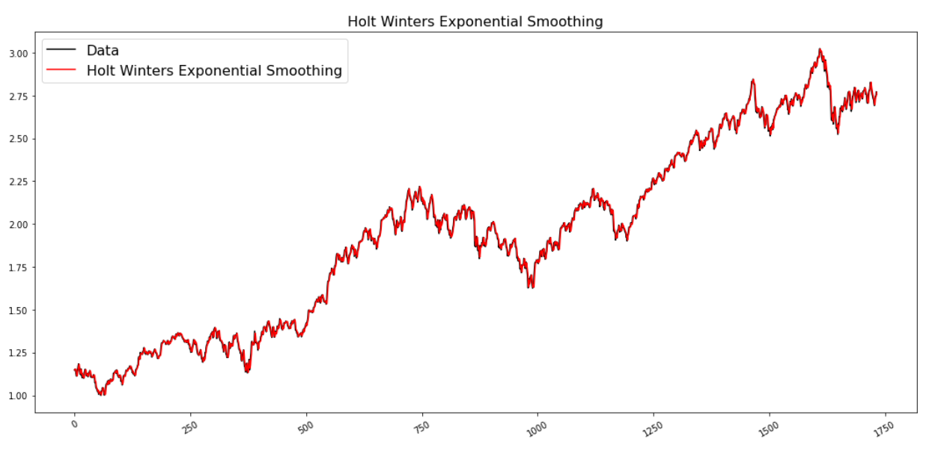
HOLT’S METHOD
Expanding the Simple Exponential Smoothing method, the Holt’s method helps you to forecast time series data that has a trend

Slide 18
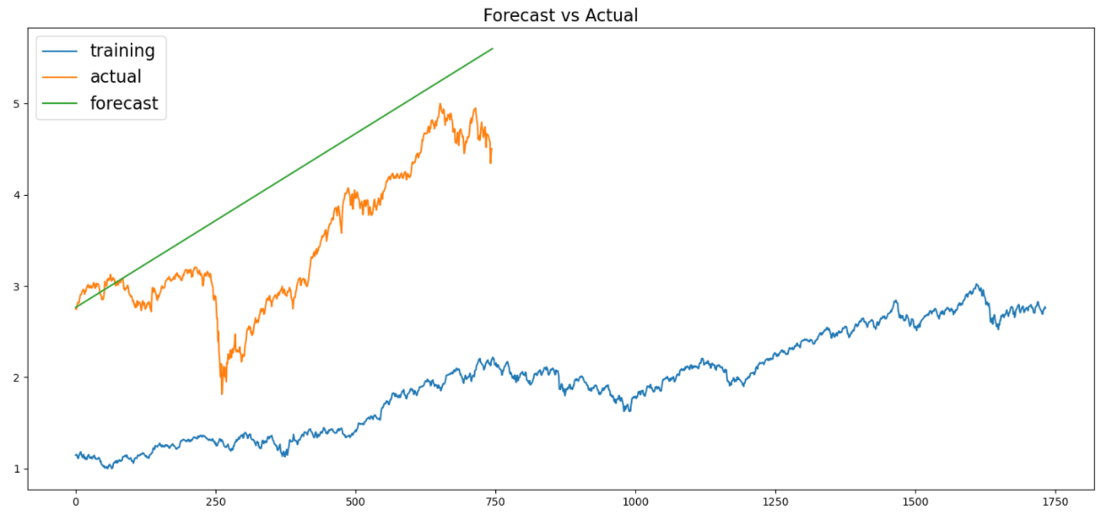
RMSE Value : 1.3415
MAPE Value : 35.6116

Slide 19
HOLT WINTER’S SEASONAL METHOD
The Holt-Winters model extends Holt to allow the forecasting of time series data that has both trend and seasonality, and this method includes this seasonality smoothing parameter.
There are two general types of seasonality: Additive and Multiplicative.
Additive: = Trend + Seasonal + Random Seasonal changes in the data stay roughly the same over time and don’t fluctuate in relation to the overall data.
Multiplicative= Trend * Seasonal * Random The seasonal variation changes in relation to the overall changes in the data. So, if the data is trending upward, the seasonal differences grow proportionally as well.

Slide 20
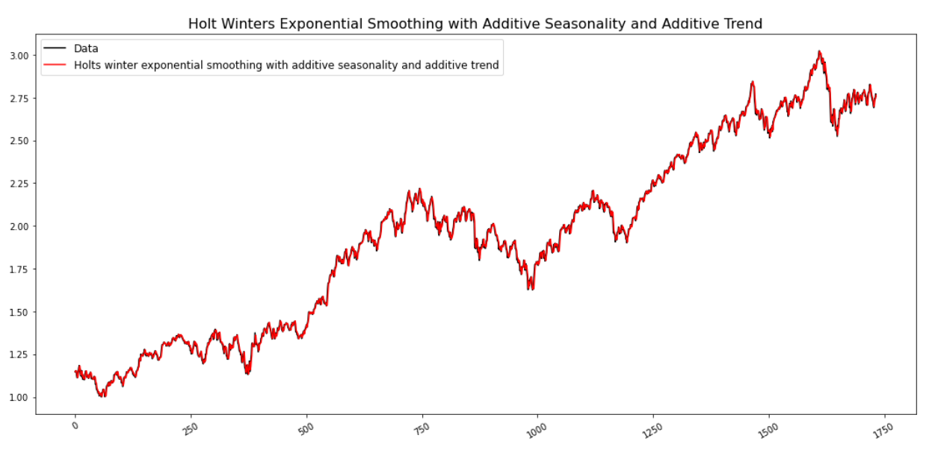
HOLT WINTER’S SEASONAL METHOD WITH ADDITIVE SEASONALITY AND ADDITIVE TREND

Slide 21
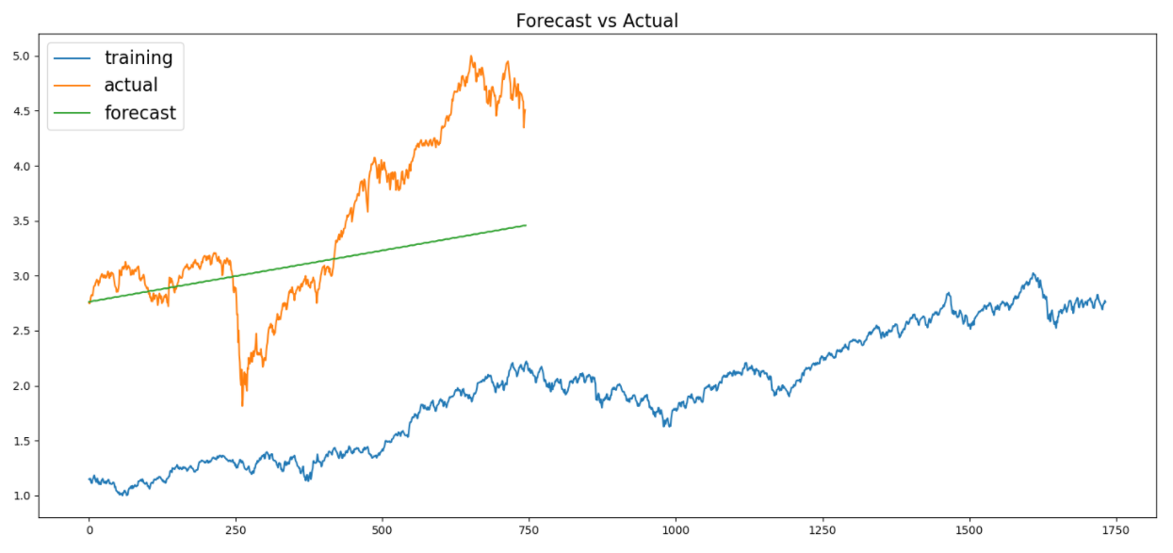
RMSE Value : 0.8792
MAPE Value : 18.2944

Slide 22
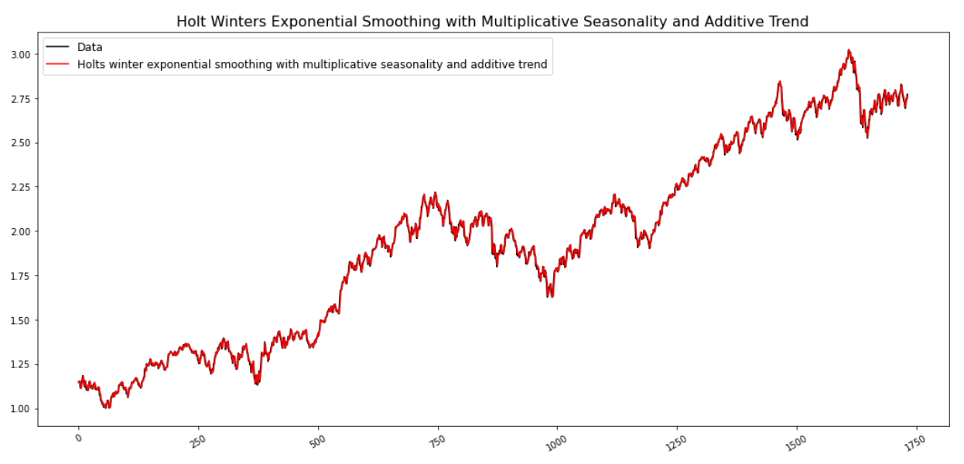
HOLT WINTER’S SEASONAL METHOD WITH MULTIPLICATIVE SEASONALITY AND ADDITIVE TREND

Slide 23
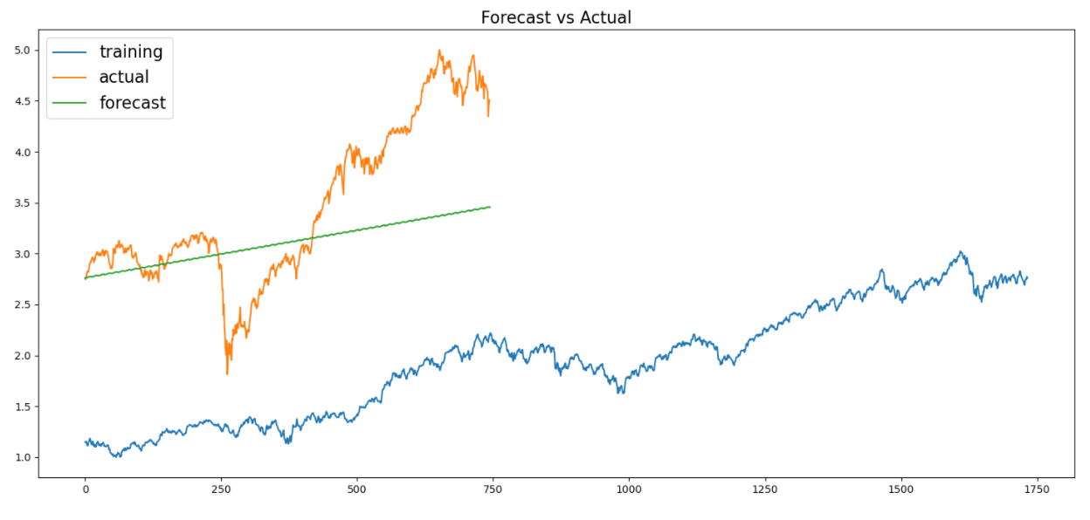
RMSE Value : 0.8793
MAPE Value : 18.2916

Slide 24
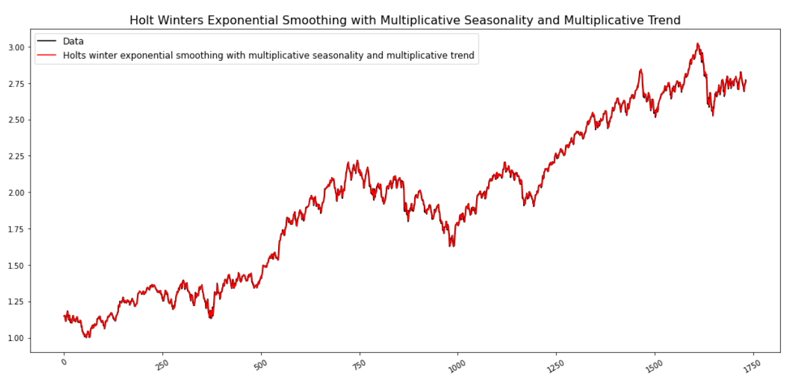
HOLT WINTER’S SEASONAL METHOD WITH MULTIPLICATIVE SEASONALITY AND MULTIPLICATIVE TREND

Slide 25

RMSE Value : 0.8631
MAPE Value : 19.1651

Slide 26
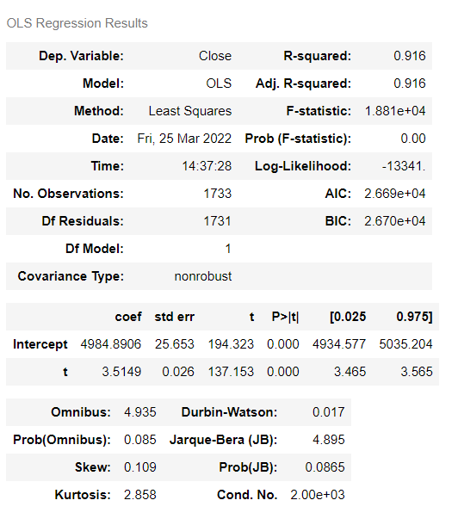
LINEAR MODEL
Standard Errors assume that the covariance matrix of the errors is correctly specified
The condition number is large, 2e+03. This might indicate that there are strong multicollinearity or other numerical problems

Slide 27
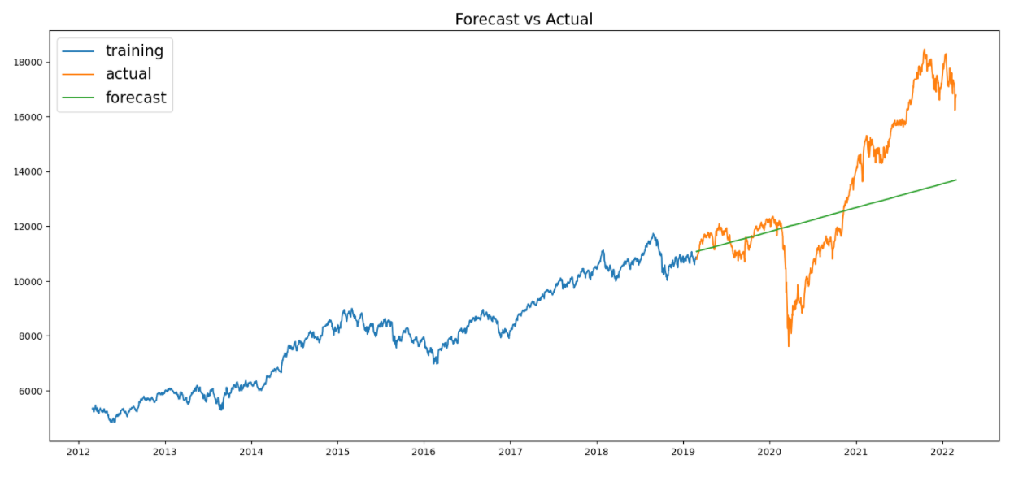
RMSE Value : 2243.4505
MAPE Value : 12.5069

Slide 28
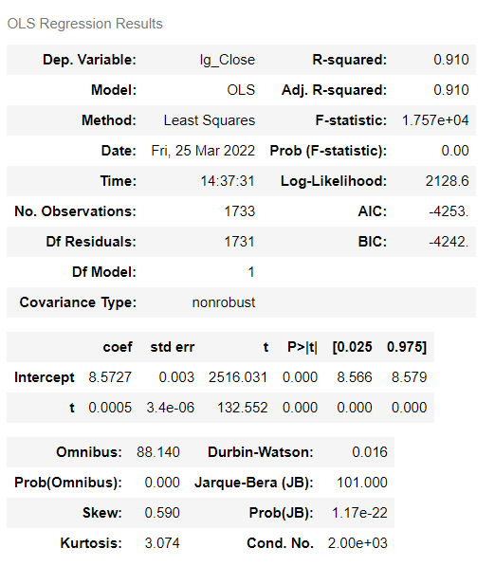
EXPONENTIAL MODEL
Standard Errors assume that the covariance matrix of the errors is correctly specified
The condition number is large, 2e+03. This might indicate that there are strong multicollinearity or other numerical problems

Slide 29
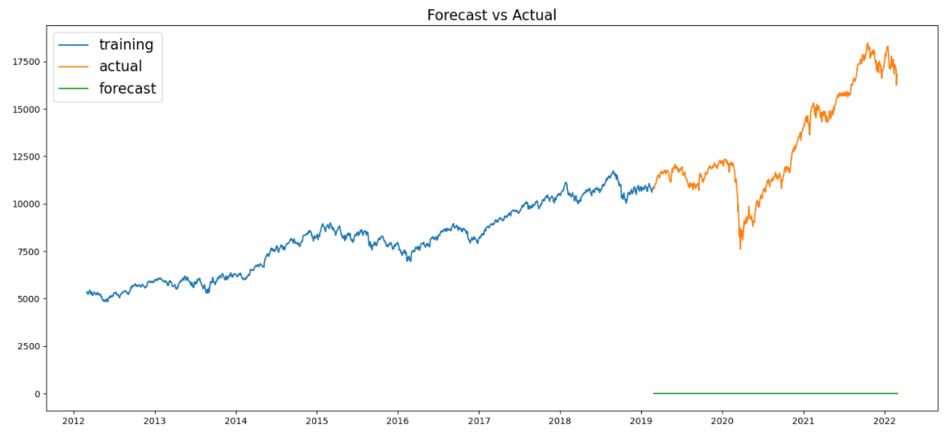
RMSE Value : 1763.7769
MAPE Value : 11.3247

Slide 30
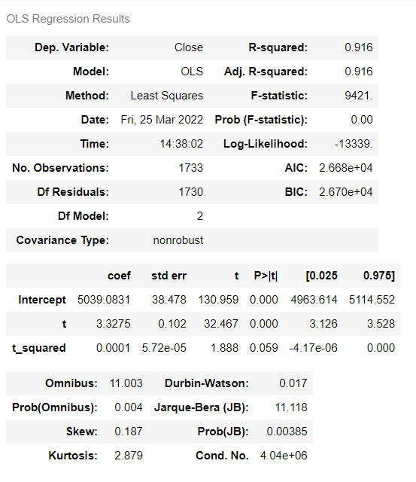
QUADRATIC MODEL
Standard Errors assume that the covariance matrix of the errors is correctly specified
The condition number is large, 4.04e+06. This might indicate that there are strong multicollinearity or other numerical problems

Slide 31
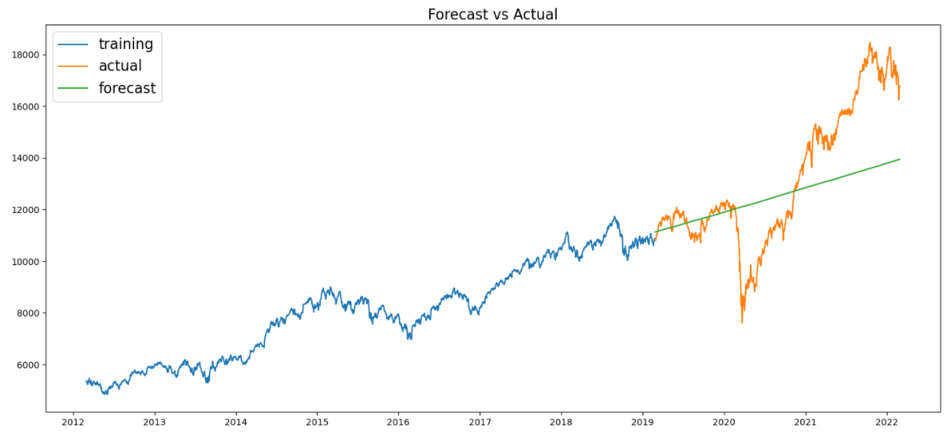
RMSE Value : 2153.4181
MAPE Value : 12.1784

Slide 32
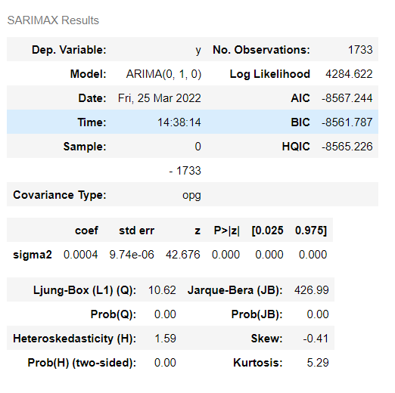
ARIMA MODEL (NON-STATIONARY DATA)
We have performed Grid search for hyper-parameters to find out optimal order or (p, d, q) for ARIMA Model (Non-Stationary Dataset)
Best order found is (1, 0, 1) with least RMSE = 0.048

Slide 33
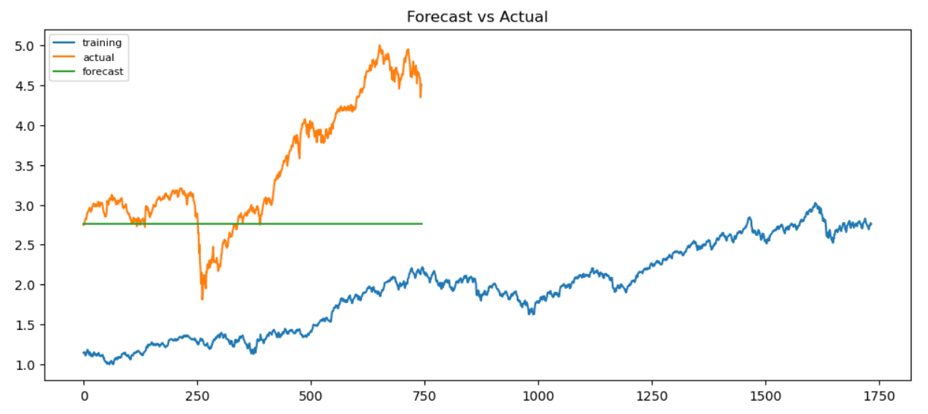
RMSE Value : 1.0500
MAPE Value : 20.1808

Slide 34
FORECASTING MODELS (STATIONARY DATA-SET)
ARIMA MODEL
AUTO – REGRESSOR MODEL
MOVING AVERAGE MODEL

Slide 35
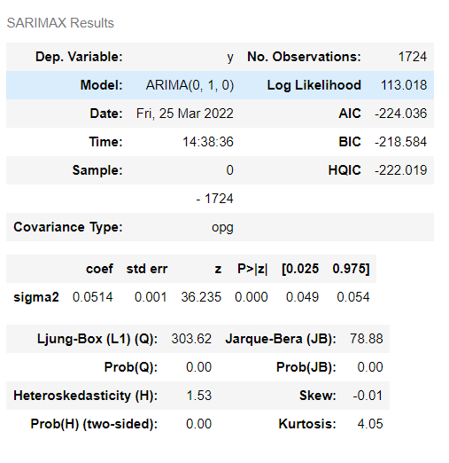
ARIMA MODEL (STATIONARY DATA)
We have performed Grid search for hyper-parameters to find out optimal order or (p, d, q) for ARIMA Model (Stationary Dataset)
Best order found is (1, 0, 1) with least RMSE = 0.048

Slide 36
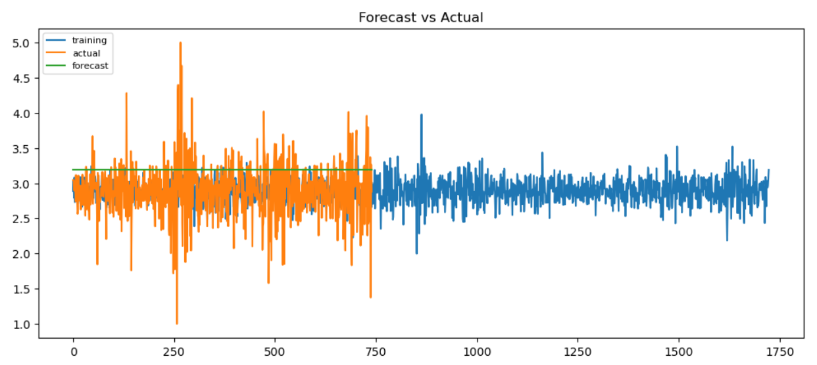
RMSE Value : 0.4881
MAPE Value : 14.8196

Slide 37
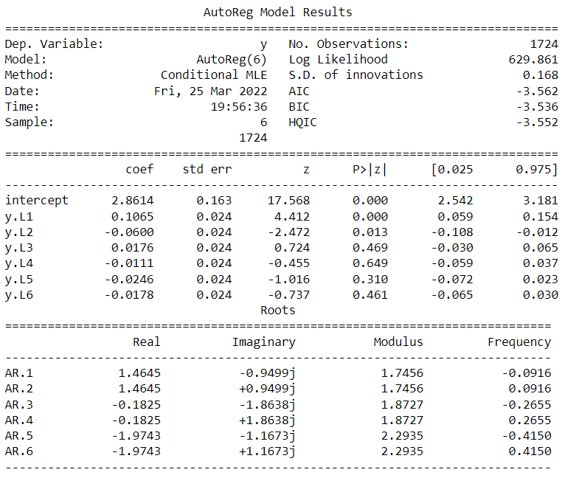
AUTO-REGRESSOR MODEL (STATIONARY DATA)
An autoregressive (AR) model predicts future behavior based on past behavior. It’s used for forecasting when there is some correlation between values in a time series and the values that precede and succeed them.

Slide 38
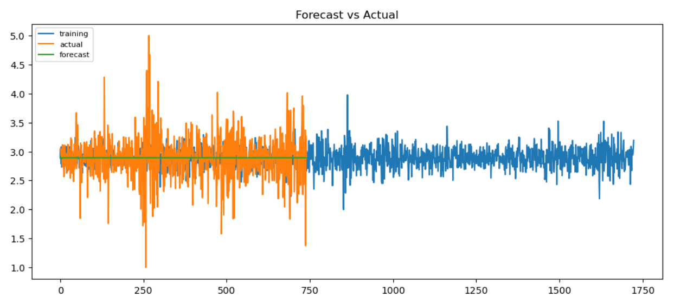
RMSE Value : 0.3834
MAPE Value : 10.1340

Slide 39
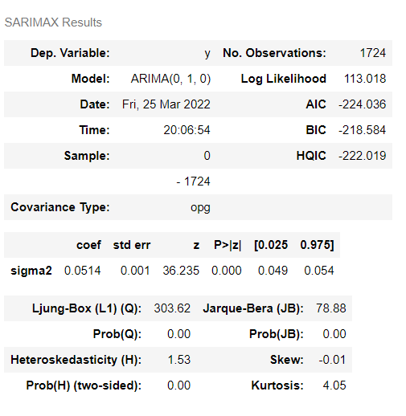
MOVING-AVERAGE MODEL (STATIONARY DATA)
The moving average model is a time series model that accounts for very short-run autocorrelation. It basically states that the next observation is the mean of every past observation. The order of the moving average model, q, can usually be estimated by looking at the ACF plot of the time series.

Slide 40
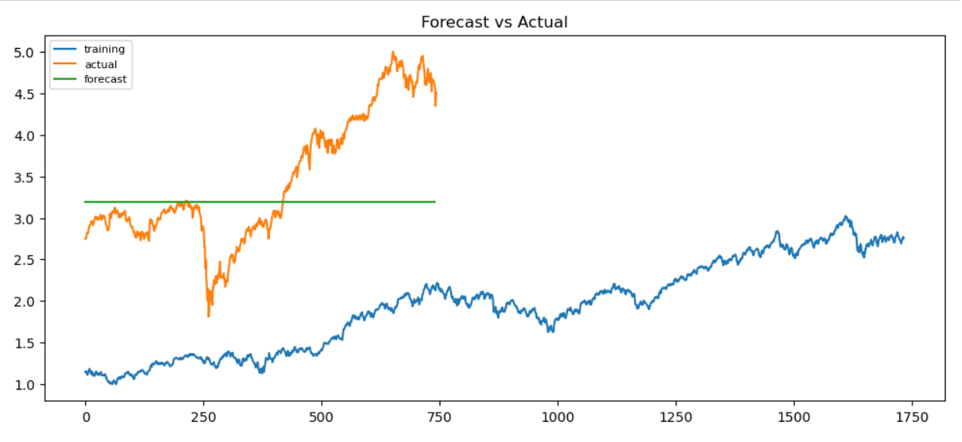
RMSE Value : 0.4881
MAPE Value : 14.8196

Slide 41
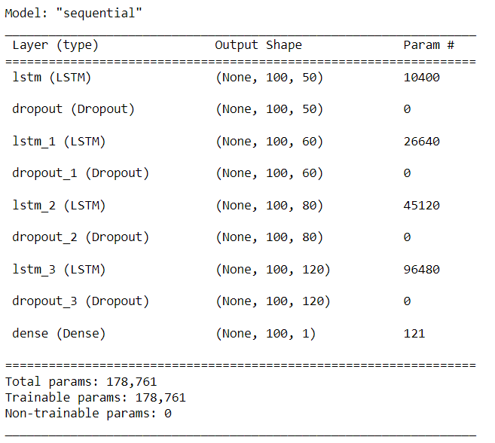
LSTM MODEL
Long short-term memory (LSTM) is an artificial recurrent neural network (RNN) architecture used in the field of deep learning (DL). Unlike standard feedforward neural networks, LSTM has feedback connections.

Slide 42
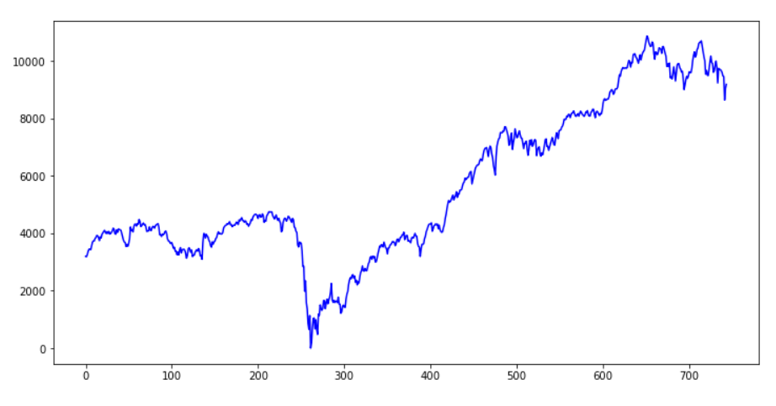
RMSE Value : 0.2475
MAPE Value : 14.8196

Slide 43
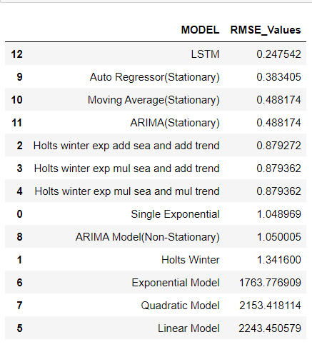
COMPARISON OF MODELS
After computing all the models we concluded that Long Short Term Memory (LSTM) Model is best model for our predictions and forecasting as it is having the least RMSE Value (RMSE = 0.2475)

Slide 44
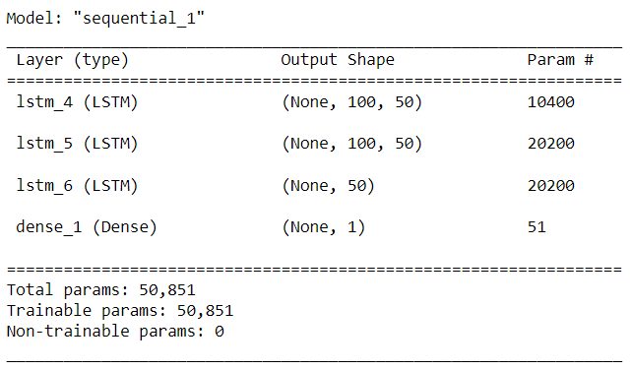
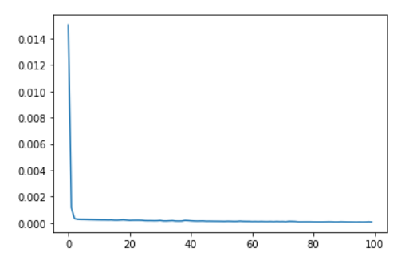
FINAL MODEL
LSTM MODEL
Long short-term memory (LSTM) is an artificial recurrent neural network (RNN) architecture used in the field of deep learning (DL). Unlike standard feedforward neural networks, LSTM has feedback connections.
We have build a Sequential model with Linear Activation, Adam as a optimizer and Mean Square Error as loss which is decreased drastically.

Slide 45
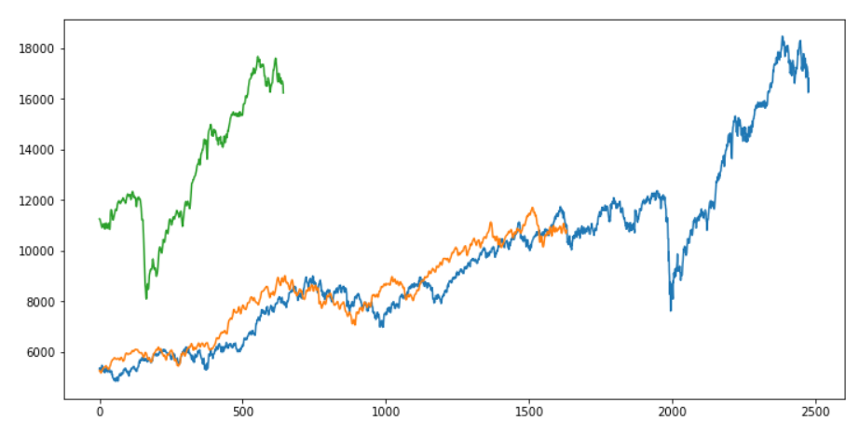
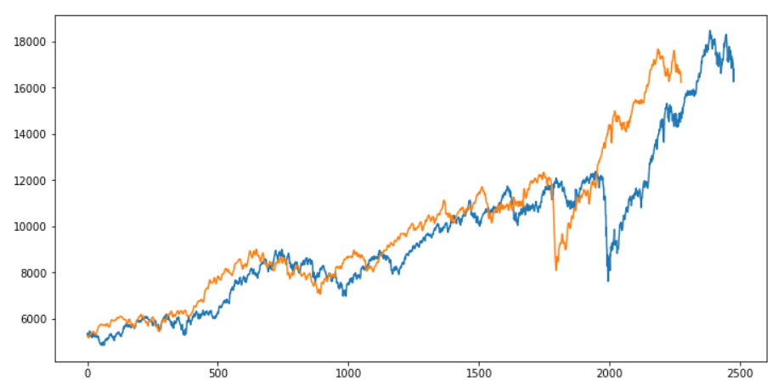
Blue Color – Original Dataset Orange Color – Predicted Train Dataset Green Color – Predicted Train Dataset
We have combined predicted train and predicted test dataset and represented it in a single graph on right.
As we can see the offset between predicted and original dataset is small we conclude that the model is predicting the almost correct values.

Slide 46
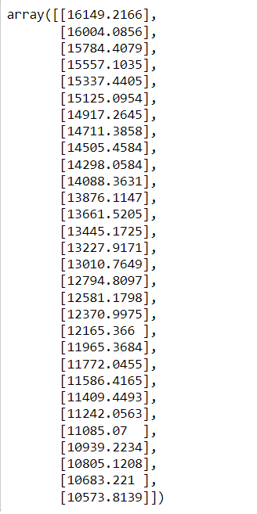
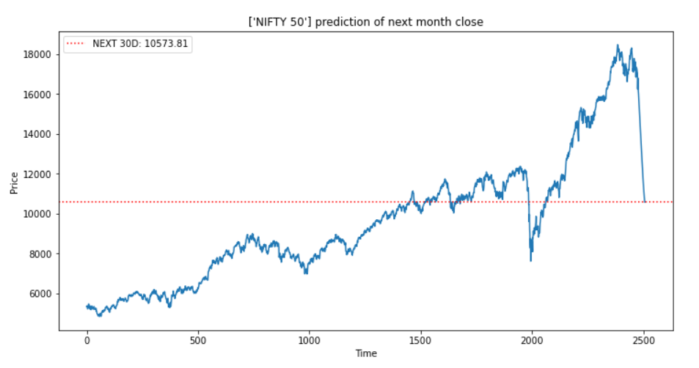
The Forecasting Graph for the Next Month Closing Price is shown with respect to the actual values.
And from the forecasting graph and array data we can conclude that there is a drastic fall in the market.

Slide 47
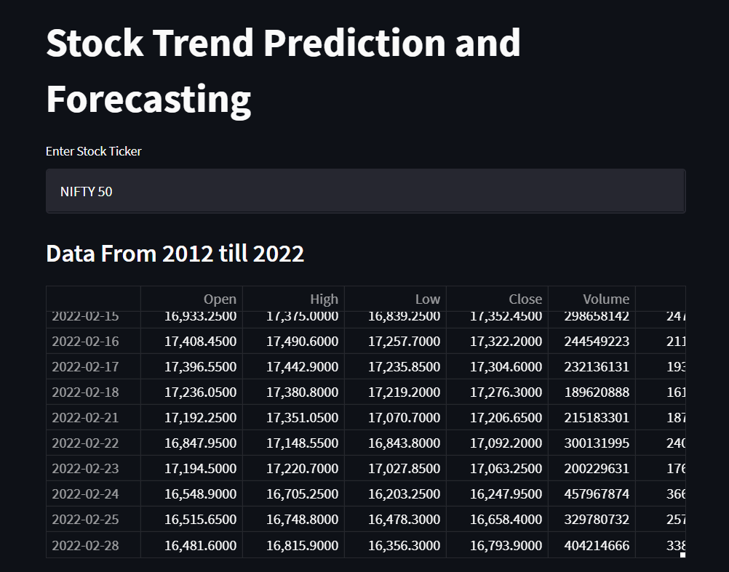
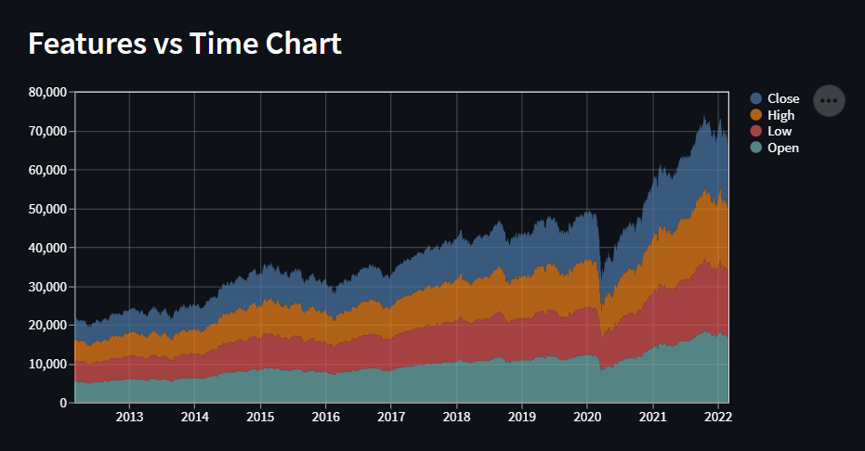
DEPLOYMENT OF LSTM MODEL
DEPLOYMENT DONE THROUGH STREAMLIT

Slide 48
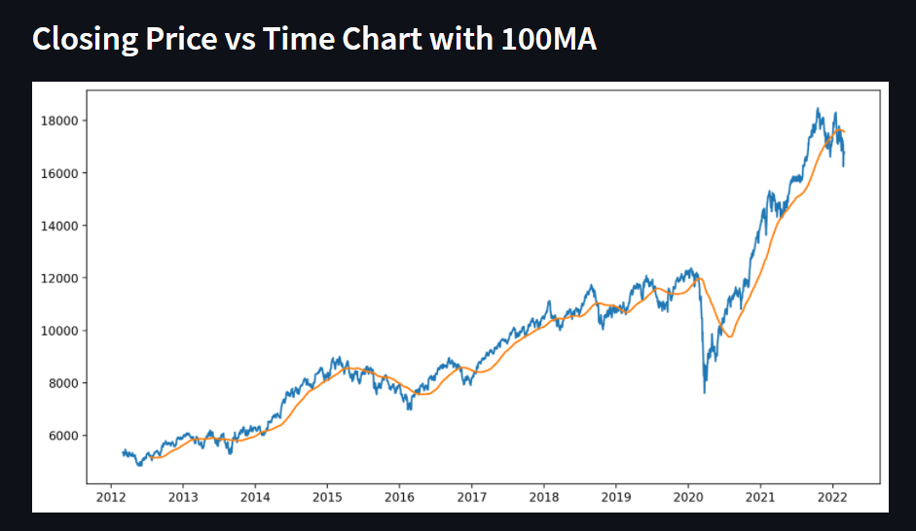




Slide 49
THANK YOU !!!!

